Slide 1
Gang Test
연구2팀 이태형

Slide 2
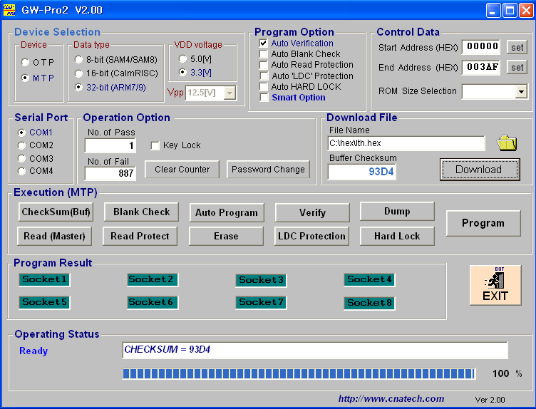
GW-Pro2

Slide 3
Program Test
Program command
REG/MEM | Mode | Address2 (A19-A16) | R/W | Address (A15-A0)
B23 | B22-B21 | B20-B17 | B16 | B15-B0
0 | 11b | xxxxb | 0 | xxxxh

Slide 4
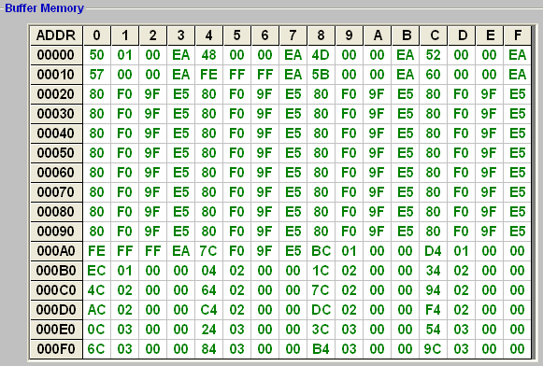
Write data

Slide 5
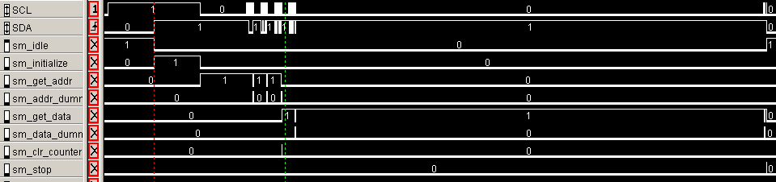
Program
Program sequence :
Start-> chip erase -> stop -> start -> program -> data
Start
Chip Erase command
Dummy &
Stop

Slide 6
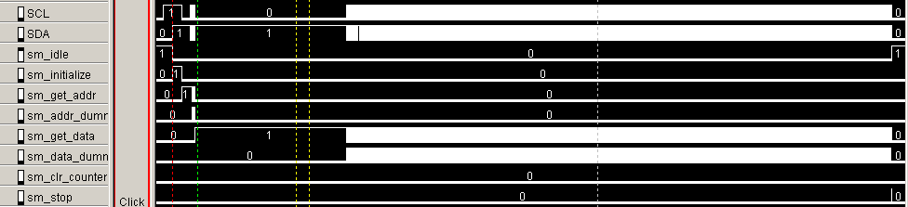
Program
Start
Program command
Data

Slide 7
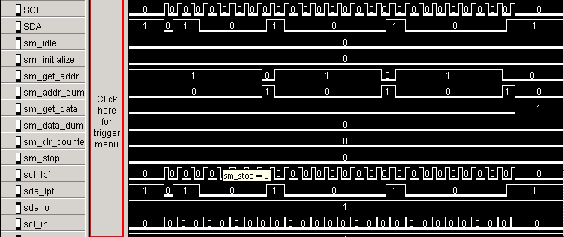
Program command 011x_xxx0
program command

Slide 8
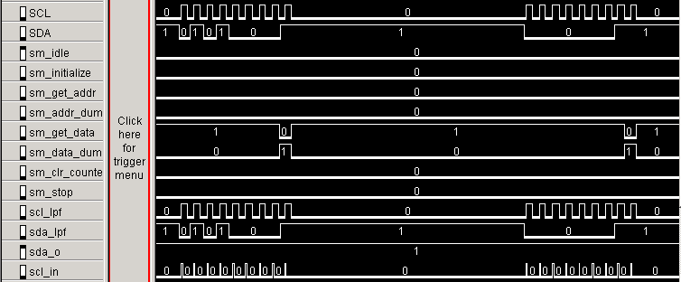
Data
Data : 0x50
Data : 0x01

Slide 9
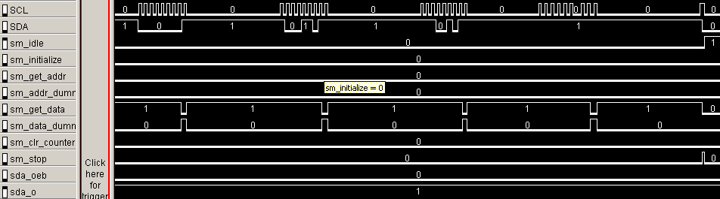
Dummy data
dummy
Stop

Slide 10
Read Test
Read command
REG/MEM | Mode | Address2 (A19-A16) | R/W | Address (A15-A0)
B23 | B22-B21 | B20-B17 | B16 | B15-B0
0 | 11b | xxxxb | 1 | xxxxh

Slide 11
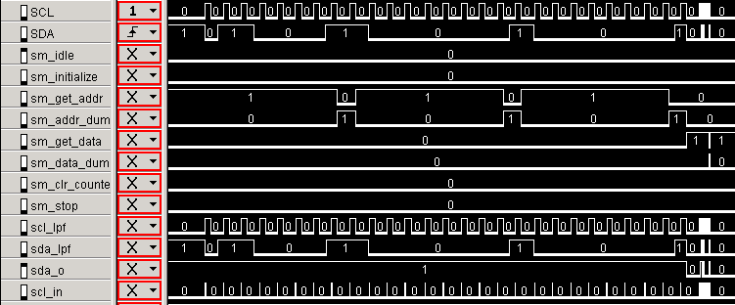
Read command
Read command
011x_xxx1

Slide 12
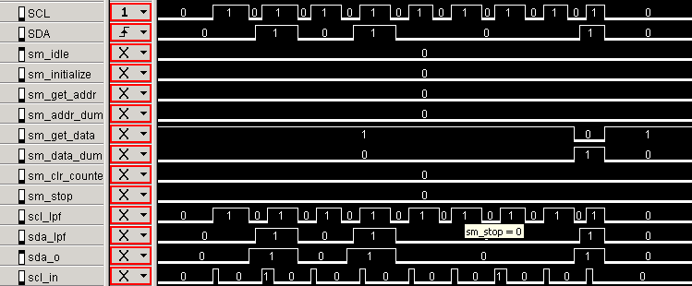
Read data
Data : 0x50

Slide 13
Read data

Slide 14
Verify Test
Verify command
REG/MEM | Mode | Address2 (A19-A16) | R/W | Address (A15-A0)
B23 | B22-B21 | B20-B17 | B16 | B15-B0
0 | 11b | xxxxb | 1 | xxxxh

Slide 15
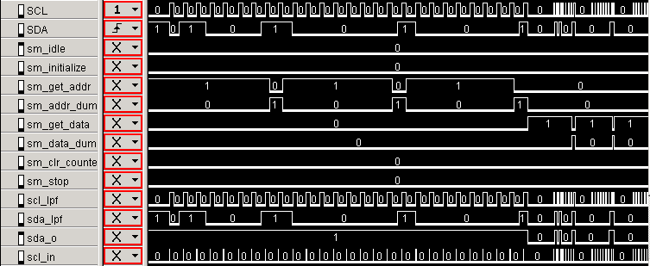
Verify command
011x_xxx1
Verify Test

Slide 16
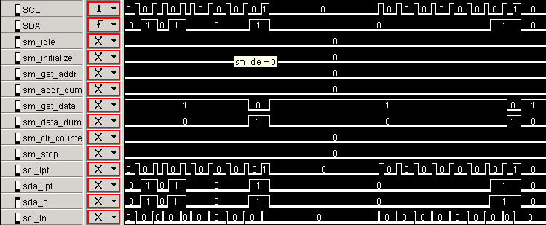
Verify data
Data : 0x50
Data : 0x01

Slide 17
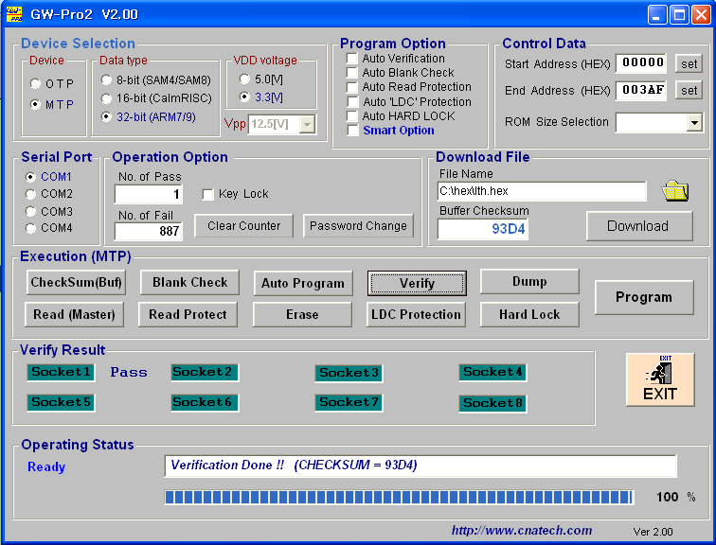
GW-Pro2

Slide 18
Chip Erase Test
Chip Erase command
REG/MEM | Mode | Address2 (A19-A16) | R/W | Address (A15-A8) | Address (A8-A0)
B23 | B22-B21 | B20-B17 | B16 | B15-B8 | B8 – B0
1 | 11b | 0000b | 0 | ---1,0101h | ----,----b

Slide 19
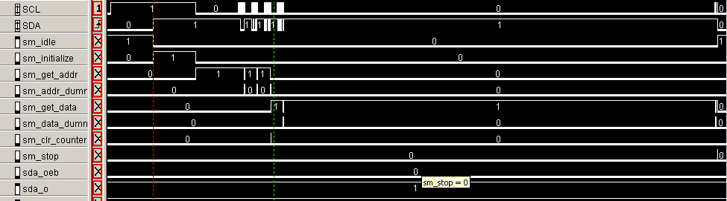
Chip Erase command
Dummy data & stop
Chip Erase Test

Slide 20
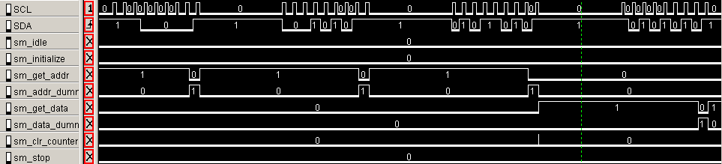
Chip Erase command
Chip Erase :
1110,0000
Chip Erase :
---1,0101

Slide 21
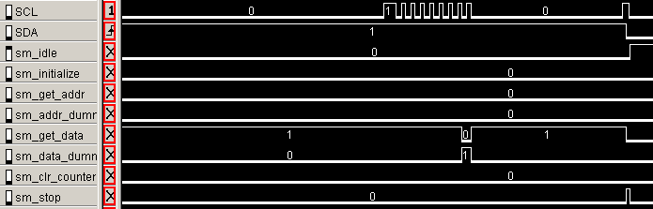
Dummy data & stop
Dummy data
Stop

Slide 22
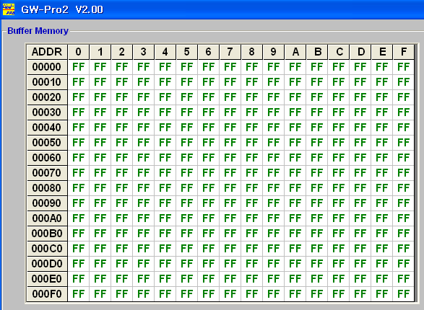
Read data

Slide 23
Read protection
Read protection command
REG/MEM | Mode | Address2 (A19-A16) | R/W | Address (A15-A8) | Address (A8-A0)
B23 | B22-B21 | B20-B17 | B16 | B15-B8 | B8 – B0
1 | 11b | 0000b | 1/0 | ---0,1110h | zz11,1100b
Data (D7-D0) | Data (D15-D8) | Data (D23-D16) | Data (D24-D31)
FFh | FFh | FFh | F7h

Slide 24
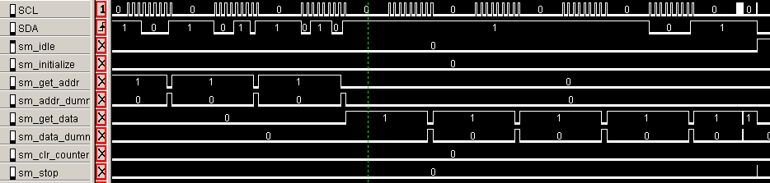
Read Protection command
1110,0000
---0,1110
zz11,1100
0000,0000

Slide 25
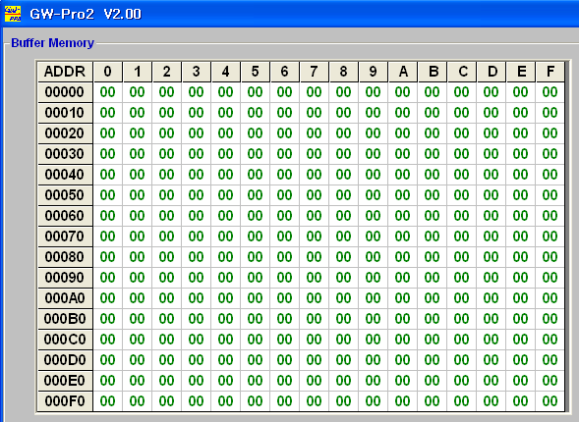
Data read

Slide 26
Hard Lock
Read protection command
REG/MEM | Mode | Address2 (A19-A16) | R/W | Address (A15-A8) | Address (A8-A0)
B23 | B22-B21 | B20-B17 | B16 | B15-B8 | B8 – B0
1 | 11b | 0000b | 1/0 | ---0,1110h | zz11,1100b
Data (D7-D0) | Data (D15-D8) | Data (D23-D16) | Data (D24-D31)
FFh | FFh | FDh | FFh

Slide 27
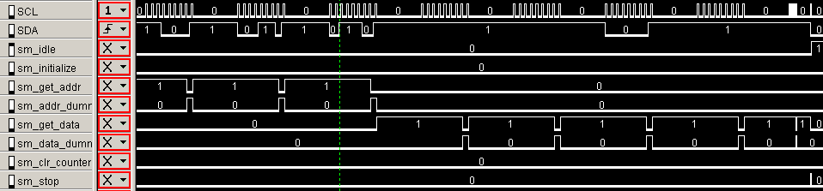
Hard Lock
---0,1110
Dummy & stop
1110,000
zz11,1100

Slide 28
LDC Protection
Read protection command
REG/MEM | Mode | Address2 (A19-A16) | R/W | Address (A15-A8) | Address (A8-A0)
B23 | B22-B21 | B20-B17 | B16 | B15-B8 | B8 – B0
1 | 11b | 0000b | 1/0 | ---0,1110h | zz11,1100b
Data (D7-D0) | Data (D15-D8) | Data (D23-D16) | Data (D24-D31)
FFh | FEh | FFh | FFh

Slide 29
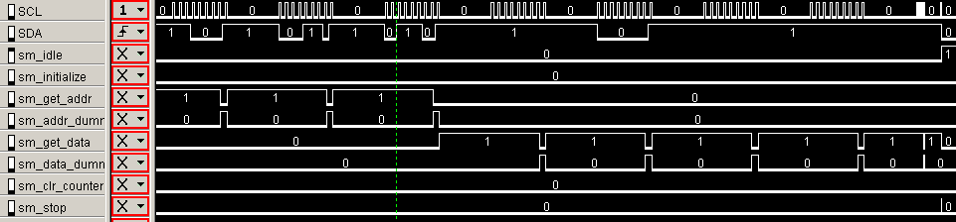
LDC Protection
---0,1110
Dummy & stop
1110,000
zz11,1100

Slide 30
Smart Option
Read protection command
REG/MEM | Mode | Address2 (A19-A16) | R/W | Address (A15-A8) | Address (A8-A0)
B23 | B22-B21 | B20-B17 | B16 | B15-B8 | B8 – B0
1 | 11b | 0000b | 1/0 | ---0,1110h | zz11,1000b
Data (D7-D0) | Data (D15-D8) | Data (D23-D16) | Data (D24-D31)
00h | 00h | --h | --h

Slide 31
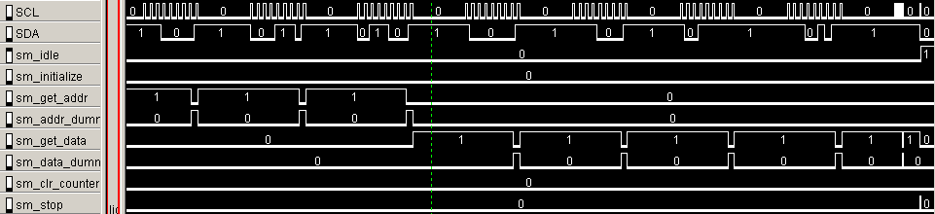
Smart Option
Sector select
data
---0,1110
Dummy & stop
1110,000
zz11,100

Slide 32
문제점
[
Erase]
ERASE
SDAT
zone
SCLK
S
1
2
~
7
8
9
1
2
~
7
8
9
1
2
~
7
8
9
1
2
~
7
8
9
1
2
~
7
8
9
P
A23
A22~A17
A16
Dummy
A15~A8
Dummy
A7~A0
Dummy
D7~D0
Dummy
D7~D0
Dummy
Clk
Clk
Clk
Clk
Chip Erase Delay
Clk
Data
-
FFH
Data
1st-3rd Byte(Address Field) – E0H,
55H,
FFH
=
FFFFFFFFh
t
  This canbeH/35H/75H/95H/B5H/D5H/F5H
Don't Care of this Value
CED
Don't care of this value
Disable Timing of this signal is controlled by Dummy clock
MAS timing diagram of F/M Core
ERASE timing diagram of F/M Core
T
T
cers
nvhl
NVSTR timing diagram of F/M Core
At
least,
ERASE
zone
>
T
nvhl

Slide 33
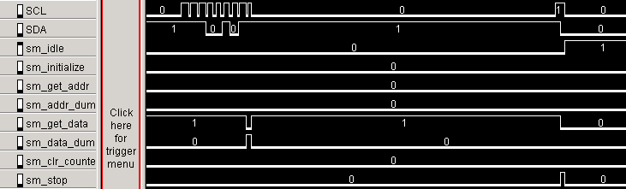
문제점
Stop

Slide 34
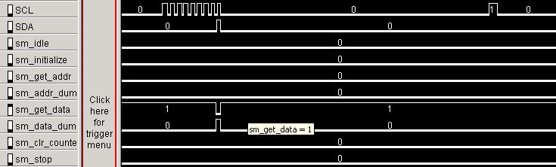
문제점
Stop

Slide 35
문제점
Toolmode전환
SCL의 주기
연속 read,write
Smart option

